Slide 1
Spring Preliminary
Budget Planning
Spring 2015
Leadership Development Department
Budgeting and Financial Planning
Office of Student Support
Federal and State Compliance
External Funding Title I & II
Multilingual Department
Student Support Services

Slide 2
Norms
Start and end of time
Actively participate
Take care of yourself
Silence your cell phones

Slide 3
Outcomes
Participants will understand how to prepare for the preliminary budget conference by considering staff configurations, monitoring and assimilating different funding resources, and determining enrollment projections.

Slide 4
Survey
Please provide feedback for each presenter following their presentation.

Slide 5
Planning Considerations
2015-2016 Preliminary Budget
Date: January 28, 2014
Presenter: Tony D’Angelo
Senior Budget Manager
Budgeting & Financial Planning
(713) 556-7131

Slide 6
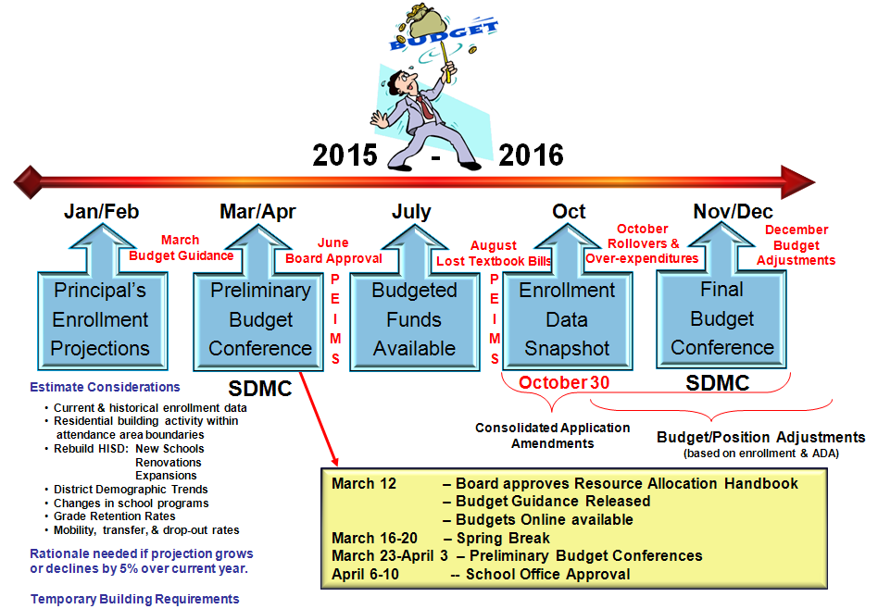
Budget Planning Timeline

Slide 7
Preliminary Budget Conference
Planning Considerations – Focus Areas
Staffing/Regular Salaries 85-90% of GF1 Average
Salary Obligations
Support Packages/Debts
Operations and Instructional Support
Instructional Program Requirements
Revenue
Expenditures
SIP
Positioning
Statement

Slide 8
Preliminary Budget Conference
Planning Considerations
Staffing / Regular Salaries -- 85-90% GF1 Average
  General Funds: Average salaries are used to fund positions.
  2014-2015: Teacher = $52,820; Teaching Assistant = $20,900
  Salaries related to GF1 position changes during FY 2015-2016 will be adjusted on a prorated basis according to the pay period beginning January 2016.
  District funds Special Education (140), Custodial (171), Food Service (977), Security (504), & Speech Therapists (132).
  When sharing positions with other schools, ensure payroll location responsibilities are well coordinated.

Slide 9
Preliminary Budget Conference
Planning Considerations
Staffing / Regular Salaries -- 85-90% GF1 Average
  Retirees have special rules and costs.
    Each retiree is different.
    Only TRS can determine the number of hours a retiree can work.
    Hours determined by retirement date and what the retiree has done since retirement.
    Retirees after September 1, 2005, that exceed the number of hours are subject to a TRS Pension Surcharge of 13.5% of employee earnings and a TRS-Care Surcharge if applicable.
    Schools are responsible for payment of surcharges.
  Part Time Degreed Teachers
    Are paid the hourly rate equivalent to the Teacher Salary Schedule. Service credit experience and degree determines placement on the schedule.

Slide 10

Preliminary Budget Conference
Planning Considerations
Staffing / Regular Salaries -- 85-90% GF1 Average
  Salaries should be assigned to the appropriate sub-object based on the courses taught:
    Math – 10 Science – 20 Reading – 30 ELA – 40
    Fine Arts – 50 College/Career – 60 Safety – 70
  Personnel Reassignment Criteria is found in Board Policy DFFA Local.
The reassignment criteria addressed in DFFA Local includes: Seniority, Performance, Extra Duties/Supplemental Assignments, and Professional Background.

Slide 11

Preliminary Budget Conference
Planning Considerations
Staffing / Regular Salaries -- 85-90% GF1 Average
  Expirations/reductions in Federal, State, and Local grants require positions to be reviewed for need and alternate funding.
  Special Revenue: Actual salaries and benefits are used.
Use the SR1 Budget Template to determine the cost of benefits.
Plan on using actual salaries and benefits for federal, state, & local grants.

Slide 12
Preliminary Budget Conference
Planning Considerations
2. Salary Obligations
Substitute Teachers | Extended Time
- Degreed | Tuition Funded Positions
- Dedicated | Overtime Support Staff
- Long Term | - Custodial
Extra-Duty Pay | - Security
- Prof Development | - Maintenance
- Tutorials | - Food Service
Stipends | - Clerical
- Training | - Teaching Assistants
- District Level | Hourly Payroll
- School Initiated | Part-time Employees
Hourly rate vs stipend rate
Paid at 1.5 x Hourly Rate for all hours worked over 40 hours.

Slide 13



Preliminary Budget Conference
Planning Considerations
Board Regulation DEA3 addresses salaries and wages for hourly and part-time employees.
The HISD Compensation Manual provides salary obligation costs.
HISD
Compensation
Manual
Board
Policy
DEA3

Slide 14
Preliminary Budget Conference
Planning Considerations
3. Support Packages & Debts
Special Education Support Services -- $68 per student
Athletic Support Package (2 Year UIL Cycle) - High School -- $135,453 (maximum for all sports) - Middle School -- $52,132 (maximum for all sports)
HS UIL Academic/Fine Arts Support Packages - Academics -- $4,500-$6,000 - Concert Band -- $1,620-$3,340 - One Act Play -- $4,050-$4,850 - Choir -- $1,200-$2,400 - Debate -- $675-$925 - Solo/Ensemble -- $200-$1,000 - Orchestra -- $1,400-$3,200 - Marching Band -- $1,620-$3,240 - Mariachi -- $240-$490 - UIL Academic Tournaments - $500-$4,500 - Guitar -- $200-$1,000

Slide 15
Preliminary Budget Conference
Planning Considerations
3. Support Packages & Debts
MS UIL Academic/Fine Arts Support Packages
- Academic/Speech Competitions -- $1,800-$2,700 without Transportation - Academic/Speech Competitions -- $2,550-$4,200 with Transportation - Debate -- $990-$1,350 – without Transportation - Science Fairs -- $135 - Robotics -- $300 - History Fairs -- $135 - Spelling Bees -- $175 - Bilingual Bee -- $135 - One Act Play -- $2,070-$2,340 - Mariachi/Folklorico -- $270-$520 - UIL Concert -- $1,125-$2,250
ES UIL Academic/Fine Arts Support Packages - Academic/Speech Competitions -- $900-$1,350 without Transportation - Academic/Speech Competitions -- $1,650-$2,850 with Transportation - Spelling Bees -- $175 - Bilingual Bee -- $135 - One Act Play -- $400-$650 - Mariachi/Folklorico -- $250-$550

Slide 16


Preliminary Budget Conference
Planning Considerations
3. Support Packages & Debts
Debts Owed HISD - Over-expenditures - Lost Textbooks - Controller Statement Debts (Transportation, etc.) - Payback Agreements / IOU Contract Agreements

Slide 17
Preliminary Budget Conference
Planning Considerations
4. Operations and Instructional Support
Capital Acquisition: Furniture, Library Books, Technology | Supplies - General Office, Instructional, Clinic …
Contract Maintenance & Repair | Cell Phone Allowance
Professional and Consultant Services | Postage
Copier and Other Equipment Rentals | Print Shop, Media Services
Dues, Fees, and Registrations | Technology, A/V, Software
Food - In-services and Other Meetings | Testing Materials
Food - Instructional | Transportation Services
Food - CVBI & Special Education | Travel - Out of District
Textbooks & Other Reading Materials | Travel - In District
Region IV ESC Services | Dropout Prevention

Slide 18

Preliminary Budget Conference
Planning Considerations
5. Instructional Program Specific Costs
Athletics | Math
CATE | Physical Education
English | Science
Fine Arts | JROTC
Foreign Language | Social Studies
Library | Special Education
Magnet | Life Skills
ESL/LEP | Technology
Essential
Non-Essential

Slide 19

Preliminary Budget Conference
Planning Considerations
Department Chair input is key to determining
“Must Have”
from
“Nice to Have”

Slide 20
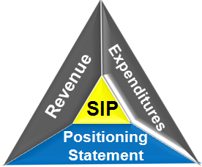
Preliminary Budget Conference
Planning Considerations
Staffing / Regular Salaries
Salary Obligations
Support Packages
Operational and Instructional Support
Instructional Program Requirements

Slide 21

Preliminary Budget Conference
Planning Considerations
Key Players
  Principal / Leadership Team
  SDMC - Shared Decision Making Committee
  Budget Subcommittee

Slide 22
Budget Subcommittee (Best Practices)
Principal is responsible for providing direction and defining areas of responsibility.
Principal ensures everyone involved understands what the term advisory means.
Common advisory functions: Informing, Examining/Studying, Prioritizing, Evaluating, Recommending, Reporting Results/Outcomes.
Principal identifies leadership. Normally the Business Manager or other administrator.
Members selected on an ability to discuss and advise in the areas of planning, curriculum, staffing patterns, staff development, and school organization, as well as budgeting.
Committee has a standard format for informing on budget status.
Committee maximizes available resources.

Slide 23
Budget Decisions (Best Practices)
Never Cut for Cutting’s Sake. Have a Reason. Ask the following tough questions about every program under review: Do we need this program? Why? Does it fit with the school’s mission, goals, and strategic plan? Do we need it in its present form? Does it need this much time? Do we need to spend this much money on it? Does it require this much staff? Does it stand alone? Can it be combined or consolidated with other programs? Is this the best we can do or can we do the same thing better, more efficiently? How? Is it duplicated somewhere else (in or out of the school)?

Slide 24
Thank you
January 28, 2014
Tony D’Angelo
Senior Budget Manager
Budgeting & Financial Planning
adangelo@houstonisd.org
(713) 556-7131

Slide 25
Survey
Please fill out the survey for this section.

Slide 26
Preliminary Spring Budget Planning
Date: 01/28/2015 & 02/05/2015
Presenter: Budgeting and Financial Planning
Stephen Moore
Budget Analyst

Slide 27
HISD School Budget Analysts
Elementary Schools
Lessie James – 713-556-6576
Rosa Diaz – 713-556-6577
Dan Nguyen – 713-556-6574
Stephen Moore – 713-556-6575
Middle Schools
Cindy Le – 713-556-6578
High Schools
Ron Parnell – 713-556-8817
Apollo Schools and Contract Charter Schools
Daniel Duong – 713-556-6593

Slide 28
Expected Outcomes
Participants will gain a better understanding of:
Budget Timeline
Membership Projection Introduction
Weighted Funding Formula/School Based Resource Allocation
Small School Subsidy
Categorical Funds

Slide 29
General Fund
Preliminary Budget Process

Slide 30
BUDGET TIMELINE
2015-2016
Membership Projection
Preliminary Budget Development
Preliminary Budget
Load
Final Budget
Adjustment
Feb.
2015
March
2015
July 2015
Nov. 2015
February - Membership Projection
March - Preliminary Budget Development
- Use Projected Membership
March 23rd - Preliminary Budget Conferences
- April 8th with Budget Analyst and HR
July - Preliminary Budget Load
November - Final Budget Adjustment
- Use PEIMS Snap Shot Data
Notes:
Enrollment projection – Mail out around early January via district office.
Budget Conferences starts in February. Plan! Plan! Plan!
Plan collaboratively with other resources. Minimize changes after finalization. We will submit a change report to School Administration. Those with high frequency of changes will have to justify. Three thousand changes btw June and Aug.
Load Prelim Budget on July 1st.
Schools may be allowed to add positions if actual membership report show increases.
Final Budget conferences scheduled for November.
Enrollment data from October snapshot with one week of clean up time. Data added after snap-shot date will not receiving funds.
ADA% from July PEIMS submission (which is prior year’s data).
Enrollment - Oct PEIMS
ADA percent July PEIMS
Mobility AEIS
Economically Disadvantaged Oct PEIMS
At-Risk Oct PEIMS
Gifted and Talented Oct PEIMS
Bilingual Enrollment Oct PEIMS
CATE (FTE’s) Nov AS400

Slide 31
Preliminary Budget and Membership Projection (Intro)
The preliminary budget begins with schools projecting membership for the upcoming year. Projection is based on the continuing trends and unique circumstances that impact membership within the schools’ boundaries.
The chief school officers or designees review and approve schools’ projections.
The preliminary budget calculation uses projected membership with Special Population data extrapolated from prior year’s % and the ADA% from the prior year.
Notes:
Enrollment Projection - Review and analyze student enrollment trends, demographic changes, economic growth, promotion/retention, and surrounding competition.
Ensure timely data entry and data quality.
Do not over or under project enrollment.
Consequences include:
Over budget condition, 398s, displaced employees not able to find jobs, unable to balance prelim budget, distort PUA amount.
Develop budget in accordance to your SIP.
Address student needs in accordance with State and Federal requirements.
Promote enrollment and attendance.

Slide 32
Membership Projection Timeline

Slide 33
WEIGHTED STUDENT FUNDING FORMULA
SCHOOL-BASED RESOURCE ALLOCATION

Slide 34
Funding Variables
Membership
  EE and P-K are funded at 50% (since the state considers EE and P-K half-day programs).
ADA Percent
Special Population Students
  Free/Reduced Lunch, At-Risk, Special Education, GT, CATE, Bilingual/ESL, Homeless and Refugee.
  The weighted student funding formula is used to generate additional funding for schools with special population students.

Slide 35
Funding Weights
Funding weights are provided to help offset the increased costs to educate students counted as special population units.
The funding weights used by HISD closely mirrors state funding.
Funding Weights:
State Compensatory Education Weight is 0.15 (At-Risk and Free/Reduced Lunch)
Gifted and Talented Weight is 0.12
Special Education Weight is 0.15
CATE Weight is 0.35
Bilingual Weight is 0.10
Homeless Weight is 0.05
Refugee Weight is 0.05
Notes:
Funding formula including student weights are approved annually by the Board.
The Decentralization Committee reviews and makes recommendation on the funding formula to ensure funding equity.

Slide 36
Example of Special Population Wt. Units
Juan Garza is an 5th grade GT student who receives Bilingual service and qualifies for the Free/Reduced Lunch Program.
GT weight is 0.12
Bilingual/ESL weight is 0.10
Free/Reduced Lunch weight is 0.075
Accurate Chancery Input Required
Juan Garza (@100% attendance) 1.0 Grade Level Unit
GT + .12 GT Unit
Bilingual/ESL + .10 Bilingual/ESL Unit
Free/Reduced Lunch + .075 Free/Reduced Lunch Unit
1.29 Total Refined Units = More $$$
Notes:
Grade level unit of 1, assumes the student has perfect attendance.

Slide 37
Per Unit Allocation (PUA)
(PUA in illustration from 2014-2015 fiscal year)
Elementary School $3,470
Middle School $3,495
High School $3,459
(plus $162 State High School Allotment)

Slide 38
Resource Allocation Summary Handout
Please Refer to Resource Allocation Summary Handout in your Package.

Slide 39
GRADE LEVEL UNITS
Item 1
Membership

Slide 40
SPECIAL POPULATION UNITS
SPECIAL POPULATION UNITS
Student
Count
Wt
Refined Units
STATE COMPENSATORY EDUC -
Item 2
FREE/RED. LUNCH UNITS - 50%
120
X
7.5%
=
9.00
AT-RISK UNITS - 50%
130
X
7.5%
=
9.75
Item 3
SPECIAL EDUCTION UNITS
20
X
15%
=
3.00
Item 4
GIFTED & TALENTED UNITS
47
X
12%
=
5.64
Item 5
CATE UNITS (FTE); based on Basic Contact Hours by course
0
X
35%
=
0.00
Item 6
ELL UNITS
(Bil/ESL identified & Served)
200
X
10%
=
20.00
Item 7
HOMELESS UNITS
12
X
5%
=
0.60
Item 8
REFUGEE UNITS
8
X
5%
=
0.40
TOTAL SPECIAL POP UNITS
48.39

Slide 41
BASIC RESOURCE ALLOCATION
Item 9
Grade Level 340.83 units
+ Special Population 48.39 units
= Total Refined Units 389 units
x PUA $3,470
= BASIC ALLOCATION $1,349,830

Slide 42
OTHER FUNDING

Slide 43
Small School Subsidy
Small schools having difficulty in meeting basic school needs may qualify for the Small School Subsidy (SSS).
Small schools generally do not enjoy the economies of scale as their larger counterparts.
SSS allocation is capped at the lower of the three measures below.
    Allocation based on subsidy units;
    15% of Base Allocation; or
    Maximum $228,480K.

Slide 44
Small School Subsidy PUA and Threshold
Small School Subsidy PUA = $850
Enrollment Threshold
Elementary School 500
Middle School 750
High School 1,000

Slide 45
Small School Subsidy
Calculation - example
Elementary School with 382 students generates a Base Allocation of $1,314,042.
(500-382) x $850 = $100,300
(15% x $1,314,042) = $197,106
Cap - $228,480
Cost/Benefit?

Slide 46
Small School Subsidy
Special Provisions
Specialty HS, due to its non-traditional characteristic and/or atypical size, get a subsidy based on an Elem. SSS Threshold.

Slide 47
  Other Allocations
  Supplemental Funding
  Capital Allocation (Fund 933) - $10 per student.
  Magnet Allocation (Fund 118) – PUA by Program Theme.
  Target School Assistance (Fund 111) – Provided by School Administration mainly to assist low performing schools.
  High School Allotment (Fund 147) – Provided to prepare students for higher education and support high school completion.
  Other General Funded programs include Carryover Fund (F115), Apollo-Elementary Schools Fund (F138), etc.
  One-Time Funding (F104) - $55 PUA, may not be available next school year.
  Special Revenue Fund – Grants including entitlement programs and competitive programs.
Notes:
Special Educ Department provides personnel according to established needs of the school. Non-payroll needs should be provided through the school’s regular fund (F101).
For a complete lists of General Fund funded programs, refer to your supplemental handouts.
Fund sources listed in the template vary by year, at the discretion of School Admin. or Program Admin.

Slide 48
Magnet Program Theme
PUA Decided by Board
Magnet Program Theme | Elementary Schools | Middle Schools | High Schools
Fine Arts | $350 | $250 | $1,150
Vanguard | $410 | $410 | $410
Montessori | $350 | $350
STEM | $125 | $150 | $150
Languages | $100 | $50 | $50
Early College |  |  | $50
Futures Academy |  |  | $300
Medical Careers Program |  | $200 | $1,225
Criminal Justice Program |  |  | $750
Engineering Careers |  |  | $750
Aviation Careers |  |  | $750
Maritime Academy |  |  | $750
Other Career Program |  |  | $50
All Other Programs | $100 | $100 | $100

Slide 49
Discretionary Funds
Non-Discretionary Funds
Discretionary Funds (Non-Restrictive)
  Funds 101, 115, 147 (Budget Flexibility)
    These funds are generally non-restrictive and may be transferred to any accounts within the same fund at the discretion of the principal and within HISD policies and guidelines.
Non-Discretionary Funds (Restrictive)
    Non-Discretionary Funds can only be used within the prescribed intent of the program, such as GT (F108), Magnet (F118), Comp Educ.(F142), CATE (F143), Bilingual (F144), SR1 Funds, etc.
Notes:
These funds may be used to provide additional assistance to students with specialized needs.
In doing so, schools must use the appropriate IA code to reflect the student population served.
Discretionary funds offer flexibility in the use of funds
Restriction on Fund 115 – contract payroll and items with re-curing costs, such as lease purchase.

Slide 50
CATEGORICAL FUNDS

Slide 51
Categorical Funds
Special Population funds which the district is required to show a minimum level of expenditures as required by the state. The spending requirement for each category is spread among HISD schools.
Categorical Funds – Spending Req’d by State
Fund 108 – Gifted and Talented
Fund 142 – State Compensatory
Fund 143 – CATE
Fund 144 – Bilingual
Fund 146 – Special Education
Homeless/Refugee funds do not have a minimum spending requirement (included in Fund 101)
Notes:
Categorical Fund is a group of funds which the district is required to show a minimum level of expenditures in relation to annual state funding by category.
Since they may only be used in accordance to the program intent, they are considered non-discretionary in nature.
All students generates Fund 101 allocation.
Special Educ, FRL, At-Risk, GT, CATE, Bilingual students generate additional allocation according to the prescribed weights.
Non-Discretionary Funds are not limited to F108, 142, 143, 144, 931.
Others are F102, 106, 113, 140, etc.
Fund 101, 108, 142, 143, 144, 931 are known as Resource Funds.
Therefore when reconciling a school’s budget, all payrolls (at average salary) + non-payroll of all resource funds must equal Total Resource Allocation.
It is advantageous to a school if the categorical funds show a decreased amount. This condition yields an increase in Fund 101, which afford the school more flexibility in usage.

Slide 52
Categorical Funds
Example: The state awards the district $1,000 for a special population group (i.e. Bilingual).
  The state requires the district to spend 52% on the school level for the Bilingual program ($520).
  The district passes the 52% requirement to each school based on their population.
  If your school holds 5% of the total Bilingual population within the district, your Bilingual allocation will represent 5% of the spending requirement ($26).
Notes:
Categorical Fund is a group of funds which the district is required to show a minimum level of expenditures in relation to annual state funding by category.
Since they may only be used in accordance to the program intent, they are considered non-discretionary in nature.
All students generates Fund 101 allocation.
Special Educ, FRL, At-Risk, GT, CATE, Bilingual students generate additional allocation according to the prescribed weights.
Non-Discretionary Funds are not limited to F108, 142, 143, 144, 931.
Others are F102, 106, 113, 140, etc.
Fund 101, 108, 142, 143, 144, 931 are known as Resource Funds.
Therefore when reconciling a school’s budget, all payrolls (at average salary) + non-payroll of all resource funds must equal Total Resource Allocation.
It is advantageous to a school if the categorical funds show a decreased amount. This condition yields an increase in Fund 101, which afford the school more flexibility in usage.

Slide 53
Categorical Funds (Cont’d)
Base Resource Allocation
minus
Fund 108, 142, 143,144, 146
= Fund 101
The school’s base resource allocation minus categorical funds determines funds available for general operating funds (Fund 101).
Notes:
Categorical Fund is a group of funds which the district is required to show a minimum level of expenditures in relation to annual state funding by category.
Since they may only be used in accordance to the program intent, they are considered non-discretionary in nature.
All students generates Fund 101 allocation.
Special Educ, FRL, At-Risk, GT, CATE, Bilingual students generate additional allocation according to the prescribed weights.
Non-Discretionary Funds are not limited to F108, 142, 143, 144, 931.
Others are F102, 106, 113, 140, etc.
Fund 101, 108, 142, 143, 144, 931 are known as Resource Funds.
Therefore when reconciling a school’s budget, all payrolls (at average salary) + non-payroll of all resource funds must equal Total Resource Allocation.
It is advantageous to a school if the categorical funds show a decreased amount. This condition yields an increase in Fund 101, which afford the school more flexibility in usage.

Slide 54
Rollout Advisory
Free/Reduced Lunch Funding Update
With the passage of the Healthy, Hunger-Free Kids Act of 2010, the National School Lunch Program (NSLP) now includes a new universal meal program called “Community Eligibility Provision” (CEP).
CEP directly identifies those students who are certified through various government food programs, thus eliminating the need to obtain eligibility data from families through a separate collection.
Historically, individual student had to apply for Free/Reduced Lunch approval to qualify for free/reduced meal provided by the District. That qualifying status is also used to determine state and Title I funding.
Beginning FY15, CEP permits eligible schools to provide meal service to all students at no charge, regardless of economic status.

Slide 55
Rollout Advisory
Free/Reduced Lunch Funding Update
If the percentage of “Direct Certified” students in a school multiplied by 1.6 is greater than 100%, then all your students are considered free meal eligible.
Starting FY16 Final Budget, if you are a CEP qualifying campus, Budgeting will NOT use the number of students who eat for free for funding purposes. Instead Budgeting will use the Economic Survey Forms submitted to Food Services for Local and State reporting purposes to determine your Free/Reduced Lunch funding.

Slide 56
Rollout Advisory
Free/Reduced Lunch Funding Update
For FY16 Preliminary Budget, Budgeting will use the FY15 percentage of the Free/Reduced Lunch count over Total Membership for the upcoming Final Budget calculation.
  e.g. FY15: 900 Free/Reduced Lunch; 1,000 total membership
  FY16: 90% x 1,200 total membership = 1,080 FRL count
If your campus is not included in CEP cluster, continue to collect and submit your Free/Reduced Lunch applications.

Slide 57
Online Budget Template
The Online Budget Template is the program that facilitates your budget allocations and position actions for staffing.
Please contact your budget analyst for guidance and assistance in using the template for allocations and position transactions.

Slide 59
Thank you
Date: Spring 2015
Presenter: Stephen Moore
Budget Analyst
smoore12@houstonisd.org
713-556-6565

Slide 60
Survey
Please fill out the section for this survey.

Slide 61
1-Year Enrollment Projections
Spring 2015
Justin Silhavy
Demographer

Slide 62
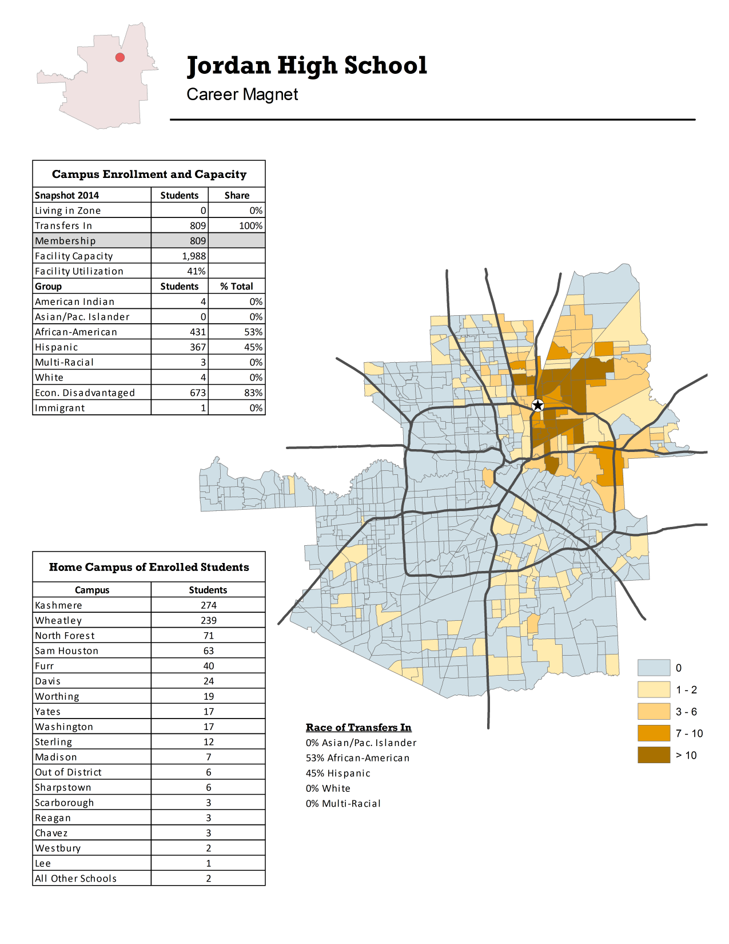
NON-ZONED CAMPUS
Students attending the campus
Neighborhood of Residence
Zoned campus of students

Slide 63
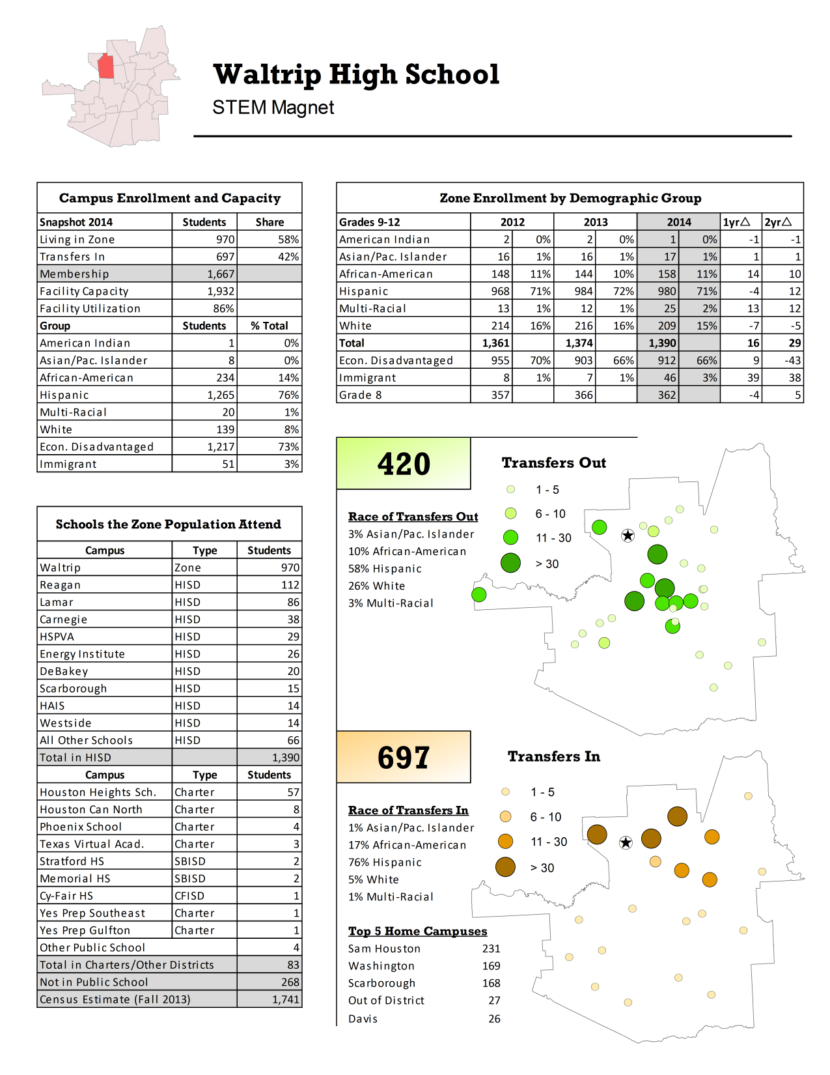
ZONED CAMPUS
Zone Students in HISD Schools
Students attending the campus
Schools the Zone Population Attend
Intradistrict Transfers

Slide 64
Expected Outcomes
The participants will:
Learn to project enrollments using current enrollment and incoming class enrollment.
Understand how housing affects enrollment.
Consider charter school changes and other variables.

Slide 65
Student Trends
Outside Variables
Enrollment Projection
Housing Changes

Slide 66
Ingredients Needed for One-Year Enrollment Projections
Enrolled Students
Housing Changes
Outside Variables
Zoning Changes
Housing Starts
Current Year
Previous School Year Data Trends
Transfer Growth/Decline
Charter Schools
Other Campus Program Changes
Incoming Grade 5 or Grade 8 Zone Population
Demolitions

Slide 67
STEP 1: Determine your Cohort Survival
(Retention and Attrition)
  The Cohort Survival Method is a statistical model used to forecast students based on current and historical enrollment. The model provides you with a base population.
  Separate transfer and zoned students.
The method sometimes must be altered:
Recent Zoning Changes
One-time demolitions that affected a large group of students
Kindergarten, Grade 6, and Grade 9
Transfer Students
!

Slide 68
Cohort Survival – High School Example
Transfers In

Slide 69
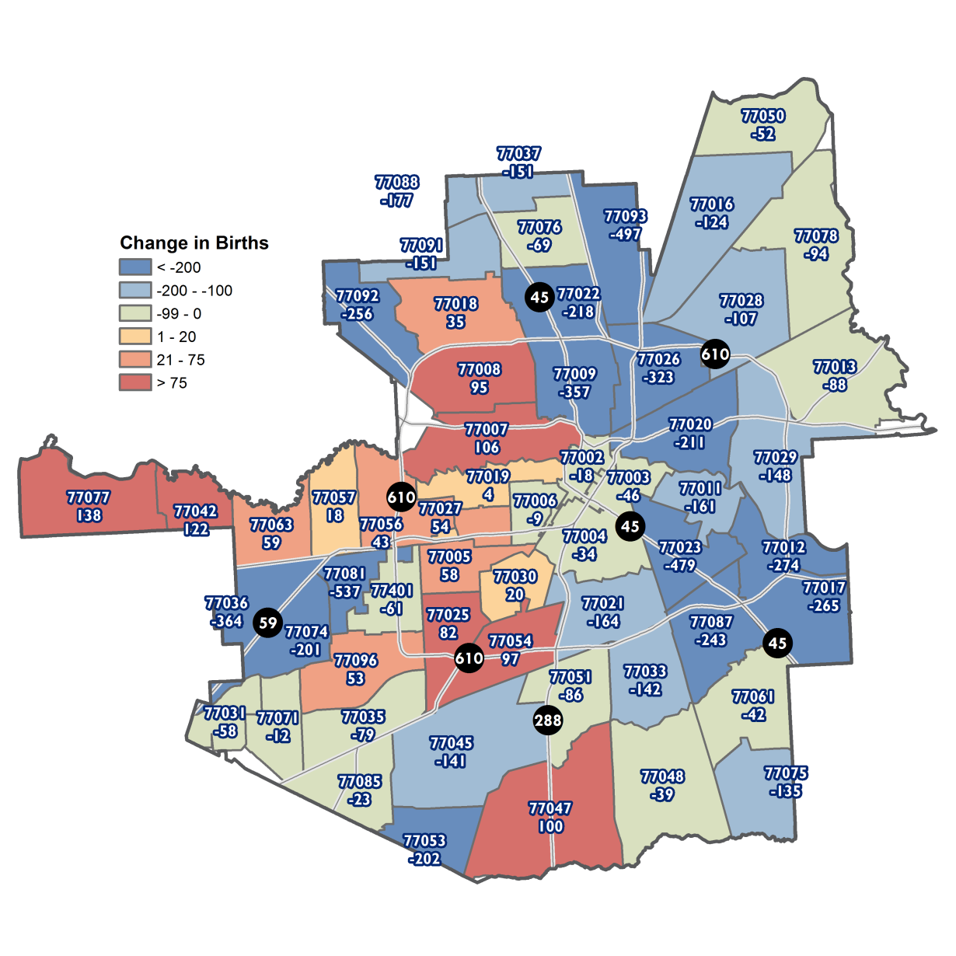
Percent Change in Live Births by Zip Code:
Ages 1-3 compared to Ages 4-6

Slide 70
STEP 2: Transfer Assessment
Transfers into your campus may need to be controlled if zoned student population growth is projected.
An increase or decrease in the number of magnet applications may warrant an adjustment for a particular grade level.

Slide 71
STEP 3: Housing Development Analysis
Demolition of multi-family structures.
Apartment renovations and rebuilds.
New housing developments.
Gentrification may add housing, but typically reduces enrollments at first.
Student yields per housing unit differ by development and region within Houston.
Housing changes by campus are available.

Slide 72
STEP 4: Zoning or Program Changes
Stay informed about possible zoning changes, school consolidations or special program changes that could impact your campus (decisions typically made prior to Spring Break).
If changes are enacted, ask the Office of Student Support for a list of students affected.

Slide 73
STEP 5: Charter School Closures and Openings
Charter Schools can impact Houston ISD campuses dramatically and sometimes little notice is given before a school is closed by the State of Texas.
Children First Academy shut down in September 2013, just weeks after school opened.

Slide 74
Thank you
Date: Spring 2015
Presenter: Justin Silhavy,
Demographer
jsilhavy@houstonisd.org
713-556-7285

Slide 75
Survey
Please fill out the survey for this section.

Slide 76
Federal & State Compliance
Date: Spring 2015
Presenter: Federal & State Compliance
Pablo Martinez,
Senior Compliance Manager
Budget Analyst

Slide 77
Disaggregation of PEIMS Student Data

Slide 78
Disaggregation of PEIMS Student Data

Slide 79
Student Data Review

Slide 80
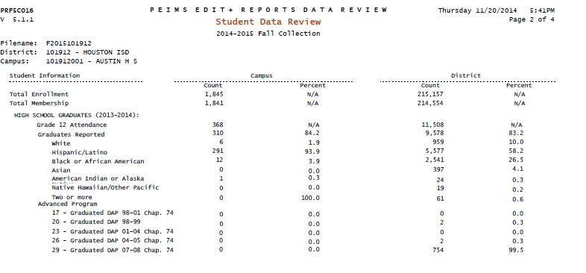
Student Data Review

Slide 81
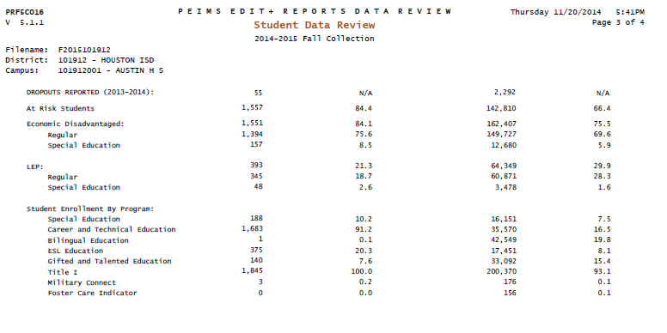
Student Data Review

Slide 82
Student Data Review

Slide 83
Campus Summary Chancery Report
CTE Contact Hours

Slide 84
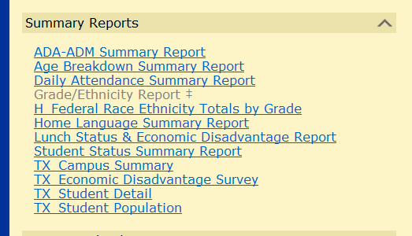
TX Campus Summary Report

Slide 85
Superintendents/Principals Semester Report of Student Attendance

Slide 86
Survey of Pregnancy Related Services
Notes:
Joe:
Please refer to the important timelines on the chart below.
Important Timelines
Last Day, Last School Year (SY) 6/8/2012
School Start Window 8/27 – 9/28/2012
Snapshot (no relation to leavers) 10/26/2012
Edit+ Presumed Under-Reported Students list (Students who were reported during the 2001-2012, but not reported anywhere during current school start window)
December 2012
Student Searches Should be Complete 1/10/2013
Resubmission Early January 2013
TEA Publishes Dropout Completion Lists Mid June 2013
Appeals Deadline Mid August 2013
Ratings Update Late October 2013
(Advance to the next screen)

Slide 87
Thank you
Date: Spring 2015
Presenter: Pablo Martinez,
Senior Compliance Manager
Budget Analyst,
pmartine@houstonisd.org
713-556-6753

Slide 88
Survey
Please fill out the survey for this section.

Slide 89
TO SPEND OR NOT TO SPEND?
Appropriate Use of Title I Funds
Date: 1/28/2015 & 2/5/2015
Presenters: Martha Medina & Tiffany Green
Title: Grants Administrators

Slide 90
Expected Outcomes
Participants will:
Understand the appropriate use of Title I Funds.
Be knowledgeable of guidelines specific to the Title I, Part A Program.
Ten Components of a Title I School wide Program.

Slide 91
Purpose & Intent of Title I, Part A Program
The purpose of Title I, Part A is to ensure
that all children, particularly low achieving
children in the highest-poverty schools, have
a fair, equal, and significant opportunity to
obtain a high-quality education and reach, at
a minimum, proficiency on challenging State
academic achievement standards and State
academic assessments.

Slide 92
Schools Eligible for Title I, Part A Funds
An HISD campus qualifies for the school wide program if 40-100 percent of their students are enrolled in free or reduced lunch.
Campuses with 35-39 percent of their students enrolled in free or reduced lunch qualifies for the targeted assistance program.

Slide 93
School-wide Program(SWP)
A Title I, Part A school wide program permits a
school to use funds from Title I, Part A and other federal education program funds and resources to upgrade the entire educational program of the school in order to raise academic achievement for all the students.
Required to include the Ten Components of a School-wide Title 1 program in the SIP.

Slide 94
Ten (10) Components of a
School wide Program
COMPREHENSIVE NEEDS ASSESSMENT | INCREASE PARENTAL INVOLVEMENT
SCHOOLWIDE REFORM STRATEGIES | TRANSITION OF PRESCHOOL CHILDREN
HIGHLY QUALIFIED TEACHERS | TEACHER DECISIONS REGARDING ASSESSMENT
PROFESSIONAL DEVELOPMENT | ASSISTANCE TO AT-RISK STUDENTS
RECRUITMENT AND RETENTION OF HIGHLY QUALIFIED TEACHERS | COORDINATION & INTEGRATION OF SERVICES & PROGRAMS

Slide 95
Core Requirements for Program Implementation
C Comprehensive Needs Assessment
Campus Improvement Plan
Evaluation/Annual Review

Slide 96
BUDGETS: FUND CODES
Campuses may use Title I, Part A, funds
only for activities that are designed and implemented to meet the educational needs of economically disadvantaged students. Activities may include, but are not limited to:
  Instructional materials and equipment;
  Employment of special instructional personnel, school counselors, and other pupil-services personnel;
  Employment and training of instructional aides;
  Training of teachers, librarians, and other instructional and pupil-services personnel;
  Parental involvement activities; and
  Planning for and evaluation of Title I, Part A, activities and projects.
* See Handout: Budget Fund Codes

Slide 97
BUDGETS
Programs purchased with Title I, Part A, funds must be scientifically research based, and these funds must be used to supplement, not supplant local or state funds.

Slide 98
Supplement, Not Supplant
Title I, Part A funds should not be used to provide services that are required by:
State Law
State Board of Education Rule
Local Policy
Supplement- to add to, enhance, to expand, to increase, to extend
Supplant – to take the place of, to replace

Slide 99
Supplanting Test
Is the activity required by state and/or local policy?
Would the activity still take place without Title I Funds?
If the answer to either question is “YES”, possibility of supplanting
increases.

Slide 100
SCENARIO #1
PINK CARD
Notes:
Scenario # 1: A Title I campus purchased a math program out of GF1 funds for the last 4 years. This year, the campus would like to purchase the math program with Title I funds. Unfortunately, the campus’ GF1 funds were cut and the principal would like to use Title I funds to purchase the math program. Is this supplanting?

Slide 101
Examples of Allowable Title I Purchases
Instructional supplies and materials
Supplies and materials for staff trainings
Printing supplies
Testing materials
Media materials
Computer software; and licenses for the software
Instructional equipment
Parental Involvement Activities
Notes:
Refer participants to the OMB Circulars A-87 on the External Funding website.

Slide 102
Examples of Unallowable Title I Purchases
No food, snacks or refreshments of any kind
Gift cards
Entertainment
Recreation
Social Events
Furniture
Clothing, uniforms, etc., unless identified as Homeless
Any materials that do not directly relate to core subject areas – reading/language arts, math, science, history or social studies

Slide 103
Scenario # 2
YELLOW CARD
Notes:
Scenario #2: Mrs. Smith is a science teacher at Desko ES. She is very excited about setting up a new science lab for the upcoming school year. Her principal allocated $400 for her to purchase items she’ll need for the science lab. Mrs. Smith submitted a list to purchase the following items: beakers, thermometers, safety goggles, graduated cylinders, vinegar and test tubes;
Are all of these items allowable Title I expenditures?

Slide 104
Instructional Materials & Consumable Supplies
Consumable items that have a useful life of 1-year or less, and an acquisition cost less than $5,000 per unit should be charged to object code 6300.
Examples of consumable items are instructional kits, workbooks, reading materials, paper supplies, etc.
Items that meet this criteria do not require TEA approval prior to purchase.

Slide 105
Items that Require Prior TEA Approval
Personnel
  All personnel paid out of Title I, Part A must complete and sign their job description
Capital Outlay (ALL items charged to object 6600)- $500 or more
* See Handout: 2014-2015 Allowable Title I Positions

Slide 106
Capital Outlay/Equipment
All capital outlay, including library books and media require specific TEA approval prior to purchase.
Equipment with an acquisition cost of less than $500 should be charged to object code 6300.
To view your approved campus-specific capital outlay log on to: ww.houstonisd.org/externalfunding.

Slide 107
Process for Submitting Capital Outlay Items
Determine items needed based on CIP(Campus Improvement Plan).
Complete justification questions (via preliminary budgeting) for each capital outlay item campus is requesting.
Determine amount needed for each item.
Include in online preliminary budget (Spring, 2015) the total cost of capital outlay item(s).
Allocate amount in object code 6632.
* See Handout: Capital Outlay Justification Questions

Slide 108
Scenario #3
GREEN CARD
Notes:
Scenario #3: Mr. Jones, principal of Clayton HS, met with his instructional staff during a staff meeting at the beginning of the school year regarding technology items needed for their classrooms. The teachers submitted various items that exceeded $500. Ms. Landry, the school secretary, submitted a shopping cart for the technology items, but the shopping cart was not approved.
List possible reasons why the shopping cart was denied.

Slide 109
Budget Timeline
ITEM | DUE DATE
Preliminary Budgeting | Spring, 2015
Capital Outlay Justifications | March, 2015
Campus Title I Budget (CA2) 2014-2015 opened | July 1, 2014
Campus Title I Budget (CA2) 2014-2015 ends | June 30, 2015

Slide 110
External Funding
Q & A

Slide 111
Department of External Funding
Contact Information
Pamela Evans,
Manager of External Funding
pevans@houstonisd.org
713.556.6928
Tiffany Green Martha Medina
Grants Administrator Grants Administrator
tgreen9@houstonisd.org mmedina1@houstonisd.org
713.556.6945 713.556.6934

Slide 112
Thank you
Date: Spring 2015
Presenters: Martha Medina & Tiffany Green
Title: Grants Administrators

Slide 113
Survey
Please fill out the survey for this section.

Slide 114
Title III, Part A Funds
Date: Spring 2015
Presenter: Jennifer Alexander,
Manager
Multilingual Department

Slide 115
Expected Outcomes
Participants will:
Understand the appropriate use of Title III Funds
Be knowledgeable of guidelines specific to the Title III, Part A Program

Slide 116
Title III, Part A—English Language Acquisition, Language Enhancement, and Academic Achievement
Allocation based on served LEP student count
May not supplant the funds
May not use funds to hire positions
Contact person is Dr. Gracie Guerrero
713-556-6961, aguerre5@houstonisd.org

Slide 117
Title III, Part A—English Language Acquisition, Language Enhancement, and Academic Achievement
District use of funds includes the following:
  Measuring and monitoring the English-language proficiency and academic progress of LEP students.
  Upgrading program objectives and instructional strategies.
  Identifying, acquiring, and upgrading curricula, instruction, materials, educational software, and assessment procedures based on research-based criteria.

Slide 118
Title III, Part A—English Language Acquisition, Language Enhancement, and Academic Achievement (cont’d)
Providing instructional support, i.e., tutorials and summer-school tuition.
Providing community participation programs, family literacy services, and parent outreach and training activities.
Providing technology support.
Providing meaningful ongoing professional development for teachers and paraprofessionals who work with LEP and immigrant students.

Slide 119
Thank you
Presenter: Jennifer Alexander,
Manager
Multilingual Department
jalexan3@houstonisd.org
713-556-6961

Slide 120
Survey
Please fill out the survey for this section.

Slide 121
Budget Reminders
State Compensatory Education (SCE)
At-Risk/Homeless/Foster Care
Date: January 28 and February 5, 2015
Presenter: Bernadette Cardenas
Student Support Services
State Compensatory Education/At-Risk/Homeless/Foster Care
713-556-6906
bcardena@houstonisd.org

Slide 122
Objectives
Participants will learn about:
Budget requirements and information for State Compensatory Education and Homeless Education
Reminders about Foster Care Education

Slide 123
STATE COMPENSATORY EDUCATION
Purpose and Intent
Compensatory education is defined in law as programs and/or services designed to supplement the regular education program for students identified as at risk of dropping out of school.
TEC § 29.081 (Handout)
State Compensatory Education funds were authorized by the legislature to provide financial support for programs/services designed by school districts to increase the academic achievement of students at risk of dropping out of school through direct instructional services.

Slide 124
STATE COMPENSATORY EDUCATION
At-risk Criteria
State Criteria for Students At Risk of Dropping Out of School (Handout)
  13 State Criteria Must be coded in Chancery and reported to PEIMS.
Local Criteria for Students At Risk of Dropping Out of School (Handout)
  Campuses must keep a list of these students (not reported to PEIMS).

Slide 125
STATE COMPENSATORY EDUCATION
Budget
Supplement, Not Supplant
Any program activity, program personnel, or program materials required by federal law, state law, or State Board of Education may not be funded with SCE funds.
SCE funds must be used to provide support programs and/or services that supplement the regular education program so that identified students at risk of dropping out of school can succeed in school.

Slide 126
STATE COMPENSATORY EDUCATION
Budget
Funding Weight – Fund 142
State Compensatory Education Weight is 0.15 (At-Risk and Free/Reduced Lunch)
Program Intent Codes -
PIC – IA 24 – SCE on a non-Title 1 campus
PIC – IA 28 – Disciplinary Alternative Ed. Program
PIC – IA 30 – Title 1 School wide activities
(SCE funds on a Title 1 School wide campus fall under the same guidelines as Title 1 funds)

Slide 127
STATE COMPENSATORY EDUCATION
Budget
By Law, SCE funds can be used for:
(1) a supplemental compensatory, intensive, or accelerated instruction program under Section 29.081;
(2) an alternative education program established under Section 37.008;
(3) support to a program eligible under Title I at a campus at which at least 40 percent of the students are educationally disadvantaged;
(4) a program specifically designed to serve students at risk of dropping out of school, as defined by Texas Education Code Section 29.081;
(5) a mentoring program for At Risk Students; or
(6) a supplement to the Dyslexia Program.

Slide 128
STATE COMPENSATORY EDUCATION
Budget
Some examples of supplemental state compensatory education programs and services include, but are not limited to:
Costs for providing accelerated instruction for students who did not pass STAAR EOC exams;
costs for program and student evaluation;
instructional materials and equipment and other supplies required for quality instruction;
supplemental staff expenses;
salary for teachers of at-risk students;
smaller class size; or
individualized instruction.

Slide 129
STATE COMPENSATORY EDUCATION
Budget
  Funds may not be spent on non-instructional positions and or services. Costs must be for instruction or instructional support (Function 11) (i.e. administrative or clerical positions) or any programs or services that do not directly impact instruction, i.e. IA 23 (Administration).
  Split-funded positions are discouraged.
  Budgets should be checked to ensure proper coding.
  Any errors or problems should be communicated to the Budget Department.
  Allowable and Unallowable Costs (Handout).

Slide 130
STATE COMPENSATORY EDUCATION
Accelerated Instruction –
STAAR End-of-Course (High Schools Only)
Accelerated instruction must be provided to any student who has failed an STAAR End-of-Course Exam (Handout).
Services provided for students who have failed an End-of-Course Exam must be budgeted separately.
Budget should be reflected with a sub-object code of 80.
These services should be allocated prior to any other funds being budget for SCE.

Slide 131
STATE COMPENSATORY EDUCATION
School Improvement Plans and Budgets
The law states the District/Campus Improvement Plan is the primary record of supporting expenditures attributed to the State Compensatory Education program.
Strategies should have the SCE budget amount in the resource column.
Any changes made to the budget or SCE programs/services at the campus should also be changed or added to the SIP.
School Improvement Plans for Improvement Required campuses will be submitted for an SCE audit each year they are categorized as Improvement Required.

Slide 132
HOMELESS EDUCATION
Definition (Handout).
There should be a Homeless Contact Person on every campus.
Student Assistance Questionnaire Sent home with EVERY student at the beginning of the year and sent home with new enrollees throughout the year (This form should be part of the enrollment packet) (Handout).
Translated into 4 languages – The forms can be found on the Homeless Education Website or the Federal and State Compliance Website.
Forms must be maintained and on file for 5 years.

Slide 133
Homeless Education Funds
Campus Support for Homeless Education
Homeless Education Contacts (Handout)
The Houston ISD Homeless Education Program:
Provides support and guidance to homeless children and youth who are in transition, who lack a “fixed, regular, and adequate nighttime residence;”
Provides uniforms, school supplies, shoes, undergarments and personal hygiene items for identified students who qualify;
Assists with enrollment, obtaining school, medical records and immunizations as well as leadership for school based personnel in identifying students and increasing community awareness; and
Collaborates with other district personnel to provide transportation, free breakfast/lunch, tutorial programs, referrals to social service agencies and resources.
Funding Weights:
Homeless Weight is 0.05
Homeless funds do not have a minimum spending requirement (they are included in Fund 101)

Slide 134
FOSTER CARE
Update
There are no funds associated with Foster Care – it is an unfunded mandate.
Foster Care students must be enrolled, regardless of documentation.
There should be a Foster Care Contact on every campus.
Foster Care data must be captured in Chancery Under Special Pops in Chancery (Foster Care) (Handout).
Data is reported to PEIMS.
All Foster Care students must be entered each year.

Slide 135
Thank you
Date: Spring 2015
Presenter: Bernadette Cardenas
Student Support Services
State Compensatory Education/At-Risk/Homeless/Foster Care
713-556-6906
bcardena@houstonisd.org

Slide 136
Survey
Please fill out the survey for this section.

Slide 137
Thank you
Date: Spring 2015
Facilitator: Dr. Samuel Maldonado,
Senior Manager, Leadership Development Department
smaldon1@houstonisd.org
713-696-0600

